Slide 1
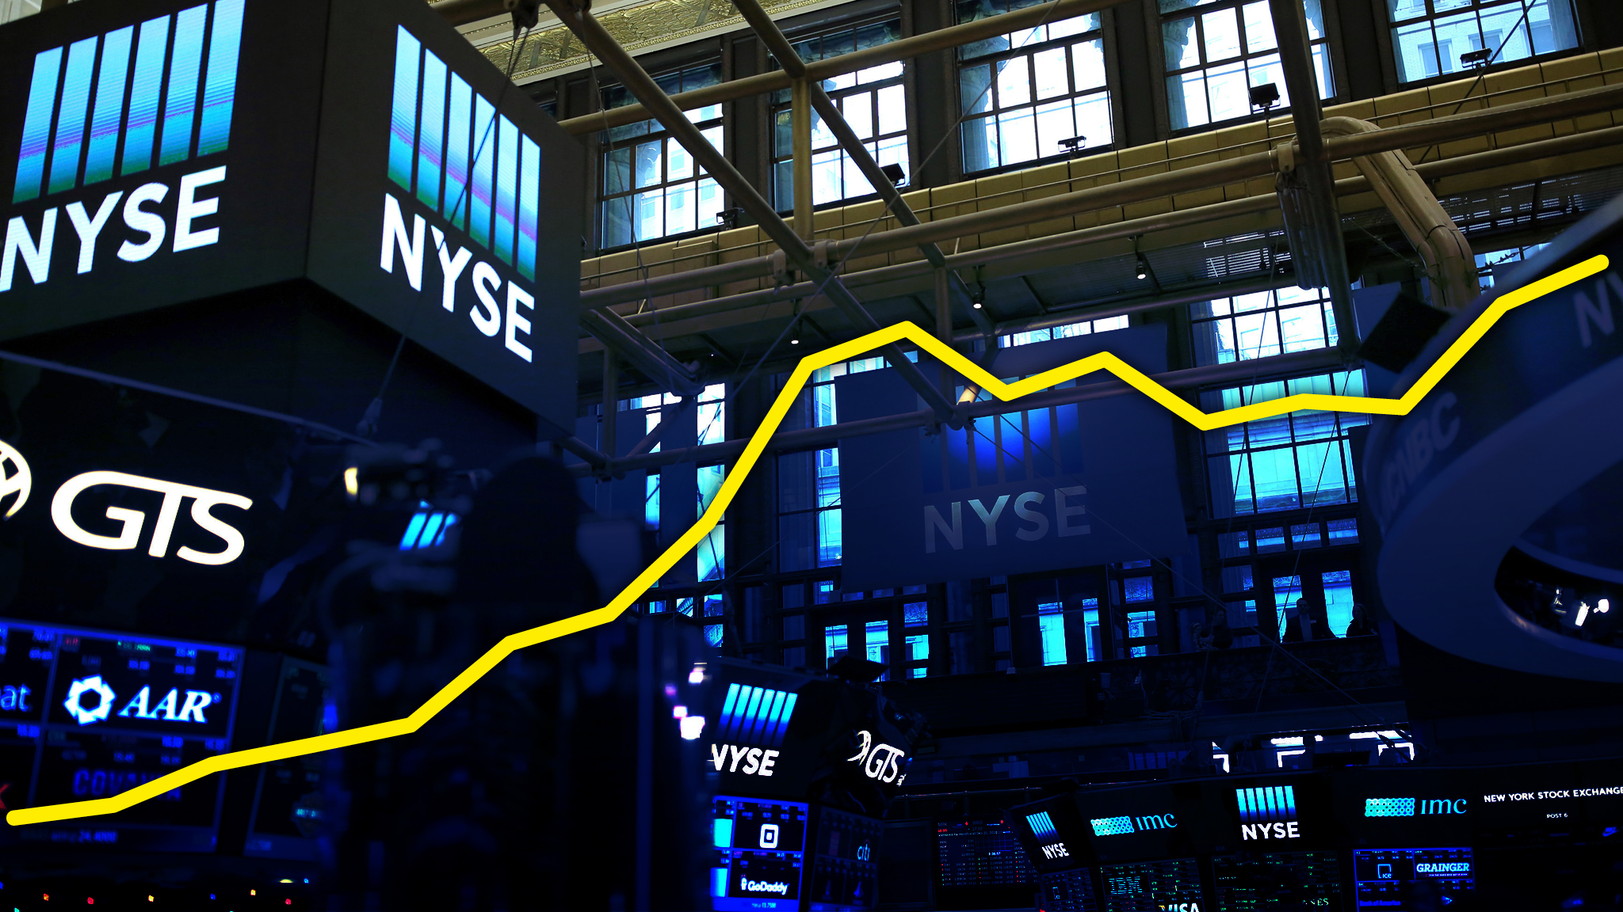
Stock Market Trading using Machine Learning
Group 13
1814054 – Jash Shah
1814055 – Jill Shah
1814056 – Vrutik Shah

Slide 2





AGENDA
Abstract
Introduction
Methodology
Result
Conclusion
“It's not whether you're right or wrong that's important, but how much money you make when you're right and how much you lose when you're wrong.”
— George Soros

Slide 3
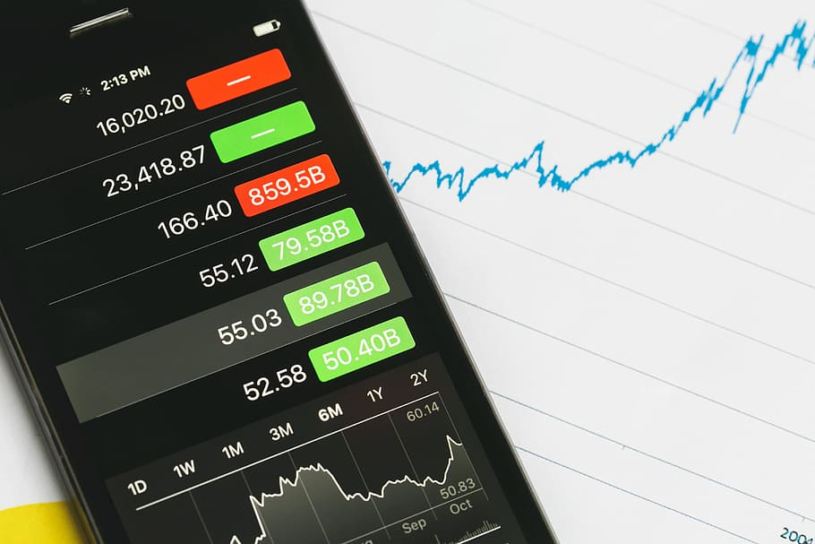
Abstract
Trading is the most important thing in the finance world. The stock market, often known as the stock exchange, is one of the most intricate and sophisticated ways to do business. Small businesses, banking industry and brokerage firms, all rely on this body to generate money and split risks; it's a sophisticated mechanism. It is critical to correctly anticipate the stock market in order to maximize profits.
As these data exist in enormous numbers and are very complicated, there is always a need for a more efficient machine learning model for daily forecasts by utilizing open-source libraries and algorithms. This survey paper will focus on various machine learning Regression and Classification algorithms.

Slide 4

Problem Definition
Every day, the stock market is mentioned in the news. Every time it achieves a new high or low, you hear about it.
If an effective algorithm could be established to anticipate the short term price of an individual stock, the rate of investment and business prospects in the stock market may increase.
So in this project we will do a comparative study of various machine learning algorithms like Linear Regression, Support Vector Machine, Decision Tree and LSTM Neural Network for efficient stock market prediction.

Slide 5

Introduction
Stock market forecasting is a technique for predicting the direction of the stock market and estimating the value of a stock or other financial asset in the future.
90 percent of the world’s data has been generated in the last few years as a result of the daily generation of 2.5 quintillion bytes of data. The financial market generates a significant amount of data. Recognizing a pattern and then devising an ideal method for making judgments is extremely tough for a trader.
One of the most difficult things to accomplish is to predict how the stock market will perform. It is critical to develop a system that will function with optimum precision and take into account all key elements that may impact the outcome.

Slide 6

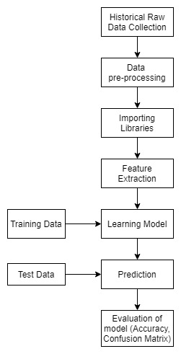
Steps for developing a Machine Learning model.
6

Slide 7




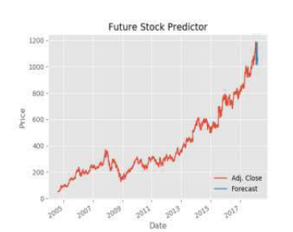
Stock Market Analysis using Supervised Machine Learning
Dataset
www.quandl.com, a leading dataset provider platform
Dataset Features
The features “Adj. Open, Adj. Volume Adj. High, Adj.Low and, Adj. Close are used.
Algorithm
Linear Regression using python libraries Scikit Learn, SciPy and Matplotlib.
Result
Accuracy: 97.6%
Kunal Pahwa, Neha Agarwal “Stock Market Analysis using Supervised Machine Learning”, International Conference on Machine Learning, Big Data, Cloud and Parallel Computing (Com-IT-Con), 2019
Reference:

Slide 8
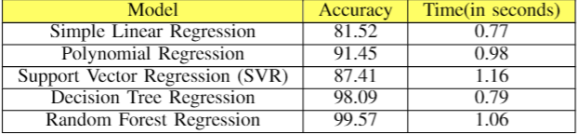
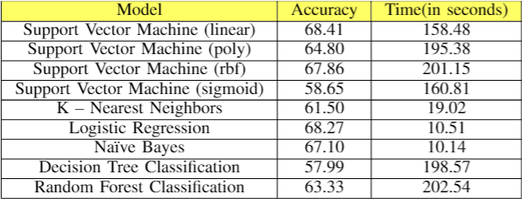
Prediction of Stock Prices using Machine Learning (Regression, Classification) Algorithms
Dataset
Yahoo Finance. It retrieves historical stock values for a firm using the ticker-name.
Dataset Features
Momentum, Volatility, Index Momentum, Index Volatility, Sector momentum, Stock momentum, Stock price volatility are added.
Algorithm
Regression - Simple Linear Regression, Polynomial Regression, Decision Tree Regression, Support Vector Regression and Random Forest Regression.
Classification - Support Vector Machine (SVM), Logistic Regression, K – Nearest Neighbours (KNN), Random Forest Classification , Decision Tree Classification, Naïve Bayes
Result
Srinath Ravikumar, Prasad Saraf ”Prediction of Stock Pricesusing Machine Learning (Regression,Classification) Algorithms”,International Conference for Emerging Technology (INCET),2020
Reference:

Slide 9

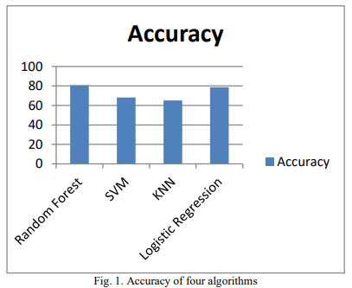
Study of Machine learning Algorithms for Stock Market Prediction
Dataset
http://www.kaggle.com, a leading dataset provider platform. Data of National Stock Exchange 2016-17.
Dataset Pre-processing
The steps included handling of missing data, hot encoding of data and normalization of data.
Algorithm
Random Forest Classifier, SVM, K- Nearest Neighbors and Logistic Regression were used with python and it’s libraries.
Result
Accuracies of Random Forest Classifier and Logistic Regression are 80.7% and 78.6% respectively.
Ashwini Pathak, Sakshi Pathak "Study of Machine learning Algorithms for Stock Market Prediction", International Journal of Engineering Research & Technology (IJERT),Vol. 9 Issue 06, June-2020
Reference:

Slide 10

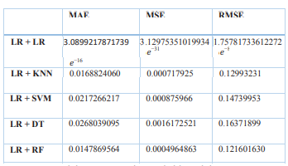
Analysis of various machine learning algorithm and hybrid model for stock market prediction using python
Approach
A hybrid approach is used over the normal one. In the proposed hybrid model a combination of two algorithms is suggested.
Why was Linear Regression used?
When various machine learning algorithms were used separately Linear Regression gave least error so it was used as a base model.
Algorithm
Linear regression is used as the base algorithm that is combined with Linear Regression, Support Vector Machine, Decision Tree and Random Forest.
Result
The Mean Absolute Error, Root Mean Squared Absolute Error and Mean Squared Error were least for Linear Regression coupled with another Linear Regression.
Sahil Vazirani, Abhishek Sharma and Pavika Sharma " Analysis of various machine learning algorithm and hybrid model for stock market prediction using python", International Conference on Smart Technologies in Computing, Electrical and Electronics (ICSTCEE 2020)
Reference:

Slide 11
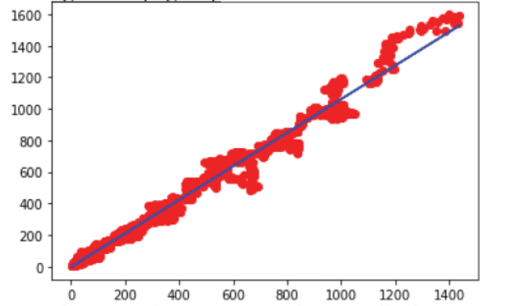
Stock Market Prediction Using Linear Regression and SVM
Dataset
Amazon stock web scrapped from yahoo finance website using Beautiful Soup
Result
Accuracy:
SVM: 94.32%
Linear Regression: 98.76%
Linear regression is better than SVM for prediction of stock price of Amazon.
Algorithm
Linear Regression and SVM for prediction of stock prices
B. Panwar, G. Dhuriya, P. Johri, S. Singh Yadav and N. Gaur, ”Stock Market Prediction Using Linear Regression and SVM,” 2021 International Conference on Advance Computing and Innovative Technologies in Engineering (ICACITE), 2021
Reference:

Slide 12

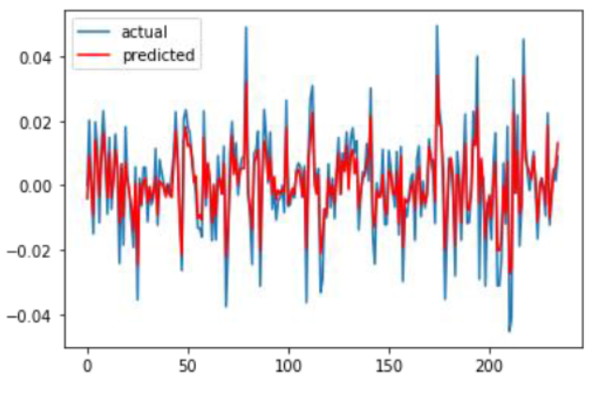
Recursive Stock Price Prediction With Machine Learning And Web Scrapping For Specified Time Period
Steps involved
Data Collection
Data preprocessing
Training the model
Recursion
Dataset
Data is real time web scrapped from real stock market websites using BeautifulSoup and NSE.
Result
The plot is made to see the actual and predicted stock prices.
Algorithm
Random Forest Regression
B. B. P. Maurya, A. Ray, A. Upadhyay, B. Gour and A. U. Khan, ”Recursive Stock Price Prediction With Machine Learning And Web Scrapping For Specified Time Period,” 2019 Sixteenth International Conference on Wireless and Optical Communication Networks (WOCN), 2019
Reference:

Slide 13
Result from Survey Papers
The table shows algorithms which are used in papers and their accuracy. The authors of the different papers have applied different machine learning algorithms to predict the future stock price.
Algorithms/Paper | Paper 1 | Paper II | Paper III | Paper V | Average Accuracy
Simple Linear Regression | 97.6 | 81.52 | - | 98.76 | 92.63
Polynomial Regression | - | 91.45 | - | - | 91.45
Support Vector Regression (SVR) | - | 87.41 | - | - | 87.41
Decision Tree Regression | - | 98.09 | - | - | 98.09
Random Forest Regression | - | 99.57 | - | - | 99.57
Support Vector Machine (linear) | - | 68.41 | 68.2 | 94.32 | 76.97
Support Vector Machine (poly) | - | 64.8 | - | - | 64.8
Support Vector Machine (rbf) | - | 67.86 | - | - | 67.86
Support Vector Machine (sigmoid) | - | 58.65 | - | - | 58.65
K – Nearest Neighbors | - | 61.5 | 65.2 | - | 63.35
Logistic Regression | - | 68.27 | 78.6 | - | 73.435
Naïve Bayes | - | 67.1 | - | - | 67.1
Decision Tree Classification | - | 57.99 | - | - | 57.99
Random Forest Classification | - | 63.33 | 80.7 | - | 72.015

Slide 14
Result from our implementation
Algorithms implemented:
Simple Linear Regression
Decision Tree Regression
Random Forest Regression
Long Short Term Memory (LSTM)

Slide 15
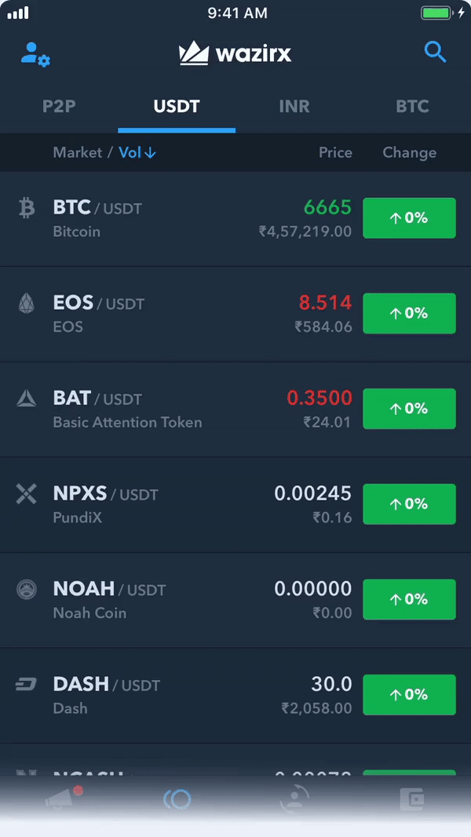
Conclusion
We implemented the Simple Linear Regression algorithm, Decision Tree Regression algorithm, Random Forest Regression algorithm and Long Short-Term Memory algorithm on the Stock market data from 4 January 2010 to 31 December 2020 to predict its stock price.
As the results show, the lowest RMSE was found for Simple Linear Regression algorithm. This was the best from all the four algorithms. The next was Random Forest followed by Decision tree algorithm to predict the nearest close value of the stock price. The most RMSE was found for LSTM.
Ranking all the four algorithms from best to least to predict the close value of stock price are:
I - Simple Linear Regression
II - Random Forest Regression
III - Decision Tree Regression
IV - Long Short-Term Memory

Slide 16

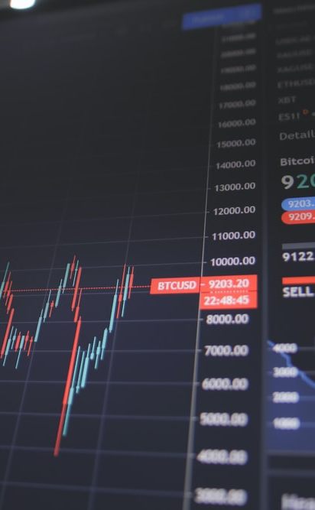
TAKEAWAY
Prediction of stock price in advance is a very good advantage for the companies as they can yield a very significant profit for their business. This ultimately benefits the customers.
Stock market trading being the most important factor in business and finance, it was necessary to develop a model that can predict the stock prices of future based on the factors which were currently in identified.
The papers have different datasets and some of them even have real time data as it is web scrapped from websites. The survey shows the algorithms used in papers and their accuracy for developing the model with respect to their dataset.
16

Slide 17
References
[1] Kunal Pahwa, Neha Agarwal “Stock Market Analysis using SupervisedMachine Learning”, International Conference on Machine Learning, Big Data, Cloud and Parallel Computing (Com-IT-Con), 2019
[2] Srinath Ravikumar, Prasad Saraf "Prediction of Stock Prices using Machine Learning (Regression,Classification) Algorithms”, International Conference for Emerging Technology (INCET),2020
[3] Ashwini Pathak, Sakshi Pathak "Study of Machine learning Algorithms for Stock Market Prediction",International Journal of Engineering Research & Technology (IJERT), Vol. 9 Issue 06, June-2020
[4] Sahil Vazirani, Abhishek Sharma and Pavika Sharma " Analysis of various machine learning algorithm and hybrid model for stock market prediction using python", International Conference on Smart Technologies in Computing, Electrical and Electronics (ICSTCEE 2020)
[5] B. Panwar, G. Dhuriya, P. Johri, S. Singh Yadav and N. Gaur, "Stock Market Prediction Using Linear Regression and SVM," 2021 International Conference on Advance Computing and Innovative Technologies in Engineering (ICACITE), 2021
[6] B. B. P. Maurya, A. Ray, A. Upadhyay, B. Gour and A. U. Khan, "Recursive Stock Price Prediction With Machine Learning And Web Scrapping For Specified Time Period," 2019 Sixteenth International Conference on Wireless and Optical Communication Networks (WOCN), 2019

Slide 18

Thank you

